Slide 1
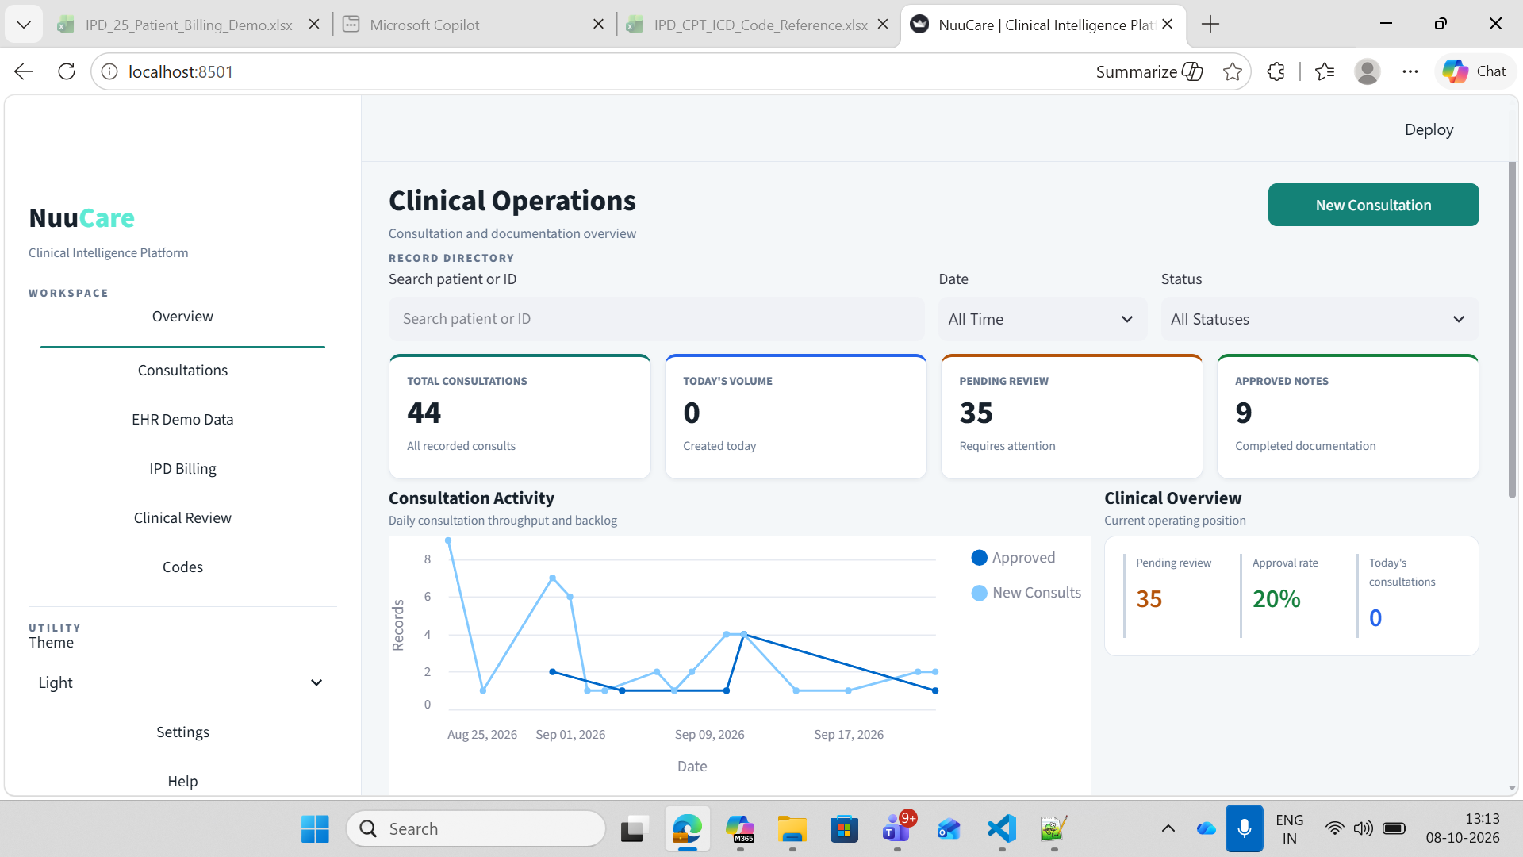
NuuCare
Proposed Admin Navigation
Clinical Intelligence Platform
A highlighted parent module with two focused experiences
WORKSPACE
Overview
Current application context
Admin module structure
Consultations
ADMIN
Operational control center
EHR Demo Data
IPD Billing
Clinical Review
▦
Admin Dashboard
Codes
Patient overview, workflow stages, filters and exceptions
ADMINISTRATION
Super Admin
⚙
◆
Admin
⌄
Users, roles, permissions and module-level access
Admin Dashboard
The new Admin module sits alongside the existing clinical workspace without changing the current navigation model.
Outcome: simple navigation, clear separation of monitoring and access control
Super Admin
Settings
Help
Notes:
Visual reference is the user-provided application screenshot.

Slide 2
NuuCare
Admin Dashboard
Clinical Intelligence Platform
All-patient overview with workflow-stage drill-down
WORKSPACE
Search patient or ID
Workflow
Stage
Date
Overview
Patient name / MRN
All workflows
⌄
All stages
⌄
Last 30 days
⌄
Consultations
EHR Demo Data
TOTAL PATIENTS
IN PROGRESS
NEEDS ATTENTION
COMPLETED
1,248
286
42
920
IPD Billing
Clinical Review
All patients
Click a stage to open patient workflow details
Selected patient details
Codes
Patient
MRN
Workflow
Current stage
Updated
CODING
Maya Shah
Aarav Mehta
MRN-10482
Consultation
Clinical Review
10:42
MRN-10479 • IPD Journey
ADMINISTRATION
Maya Shah
MRN-10479
IPD Journey
Coding
10:18
Current stage
Coding
◆
Admin
⌄
Stage owner
Coding Specialist
Admin Dashboard
Rohan Iyer
MRN-10471
Consultation
RCM Review
09:56
Entered stage
08 Oct, 09:40
Super Admin
Anaya Patel
MRN-10466
IPD Journey
09:30
Pending item
Diagnosis clarification
Completed
Priority
Needs attention
Settings
Help
Notes:
All patient names and values are illustrative mock data. The intended interaction is: default all-patient overview, then click the current-stage label to open the selected patient stage and workflow details.

Slide 3
NuuCare
Super Admin
Clinical Intelligence Platform
Role-based access so every team sees only the modules and actions relevant to the role
WORKSPACE
Overview
Users & roles
Role permissions: Coding Specialist
ACTIVE ROLE
Consultations
Search user or role
Module
View
Edit
Approve
Admin
EHR Demo Data
Coding Specialist
Clinical Overview
✓
IPD Billing
CS
Coding
Clinical Review
Clinical Review
✓
RA
RCM Analyst
Codes
RCM
Codes
✓
✓
✓
CR
Clinical Reviewer
RCM Workspace
ADMINISTRATION
Clinical Review
◆
Admin
⌄
OA
Operations Admin
All workflows
Admin Dashboard
Super Admin
+ Add user / role
Access model
Module → action → data scope
Changes are auditable and centrally managed.
Settings
Help
Notes:
Illustrative role-permission model. Final permissions should be aligned with the organization's security and compliance policy.

